Slide 1


IMPLEMENTATION OF
AVL TREE
By: A
Roll no. :
Enrollment no. : 22

Slide 2

FUNCTION
FLOWCHART
PROS & CONS

Slide 3


IMPLEMENTATION
OF
AVL TREE
FUNCTIONS
Insert Node
Is Tree Empty?
Search Node
Get Total Nodes
Remove All Nodes
Show Post Order
Show Pre Order
Show In Order

Slide 4
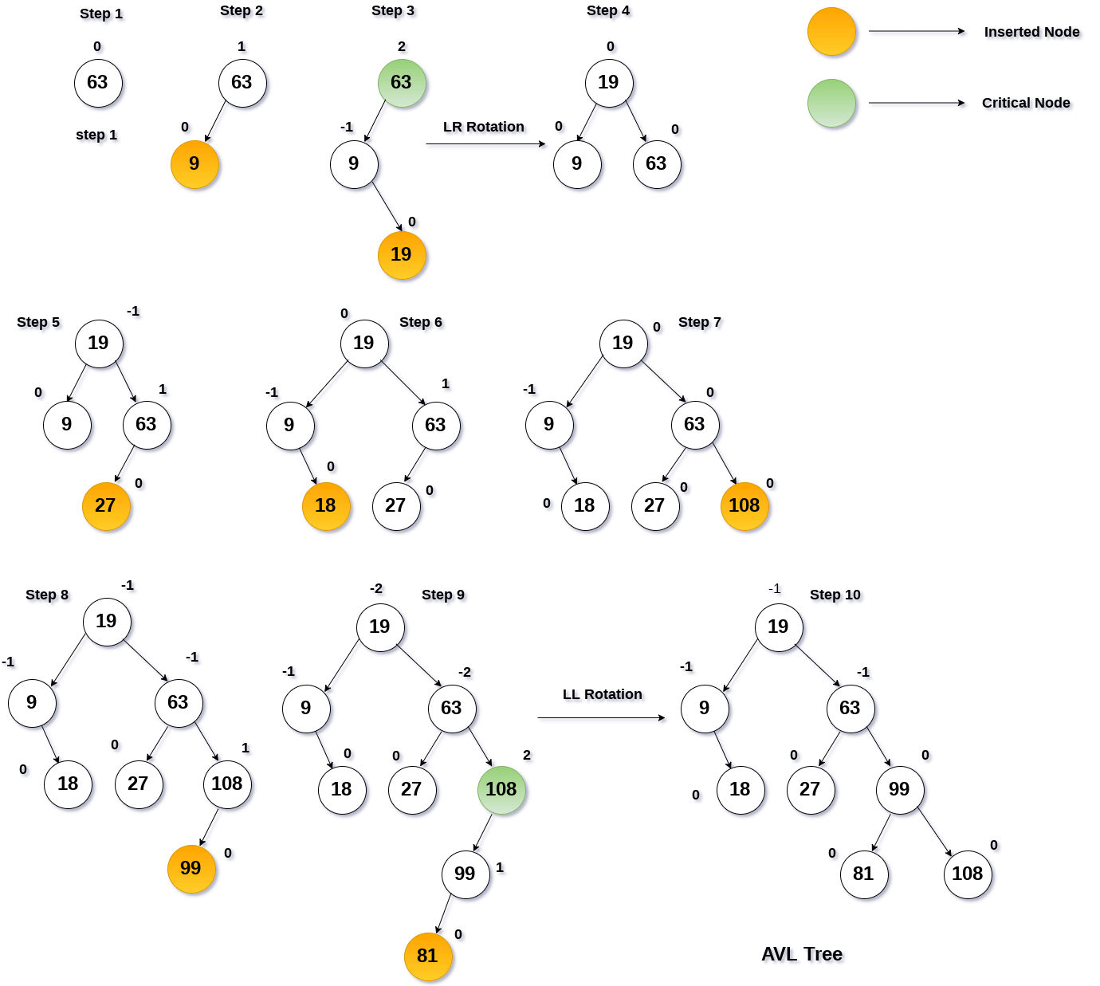
FLOWCHART
Presentation

Slide 5

Pros
Faster Search Operations
Balancing Capabilities
Cons
Slow Insert and Deletes
Fast Updating System

Slide 6
Thank You

